Slide 1

GOTYOU TELEMATICS · A CONCEPT FOR DISCUSSION WITH TRANSNET
Fuel telemetry and reconciliation, from storage tank to locomotive.
A custom fuel-monitoring system for Transnet — metering, access control and reconciliation across the diesel supply chain.
A concept for discussion · Prepared for Transnet management · June 2026
GOTYOU TELEMATICS

Slide 2
SYSTEM CONCEPT
Three metering points, reconciled in real time.
Diesel volume is measured at three independent points and reconciled continuously.
METER 1
METER 2
METER 3
Storage tank
The pump
The locomotive
=
=
80 GHz radar level · 1,000,000 L tank
High-accuracy flow meter on every dispense
2 fuel-sensor probes per tank on the 6,000 L locomotive diesel tank
Volume out of tank = volume dispensed = volume into locomotive. Any unreconciled delta is logged as a fraud or theft event.

Slide 3
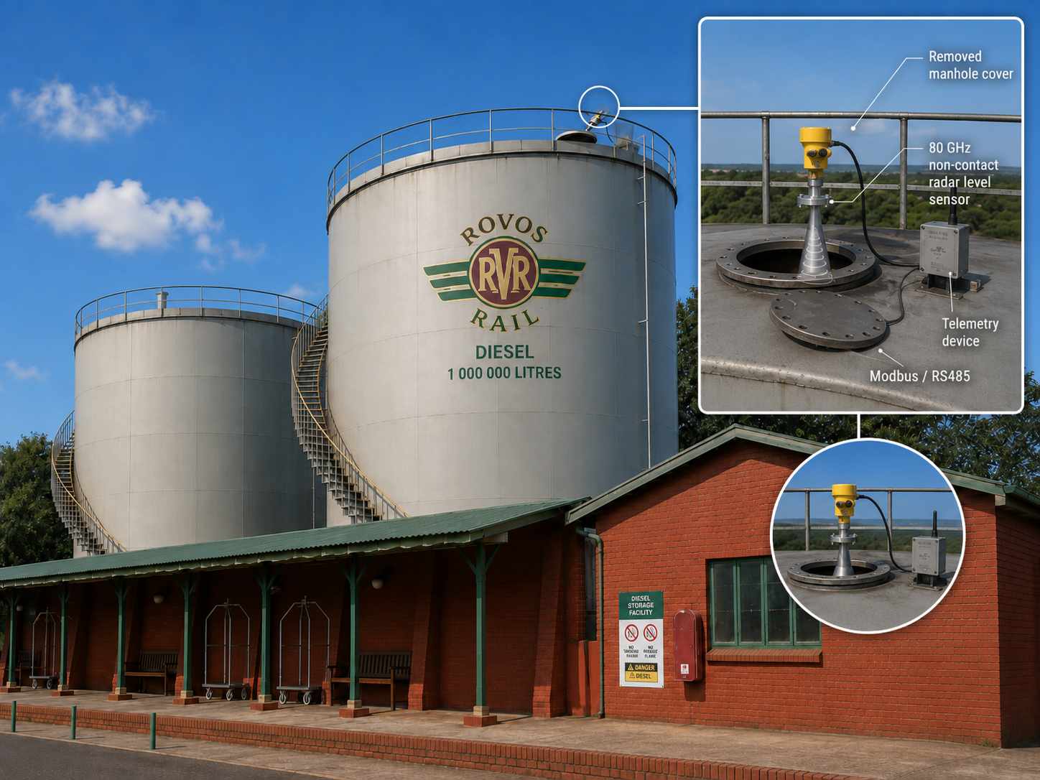
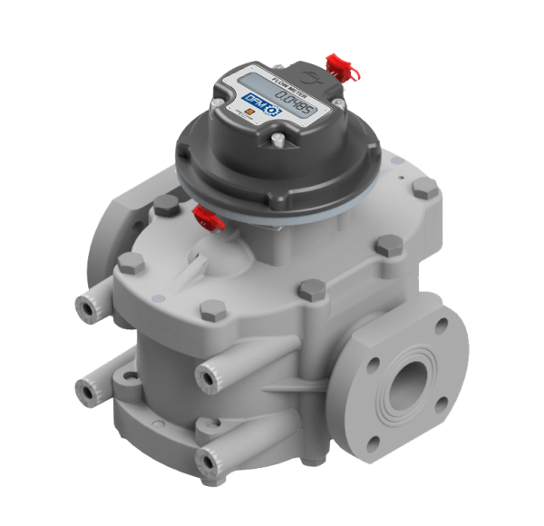
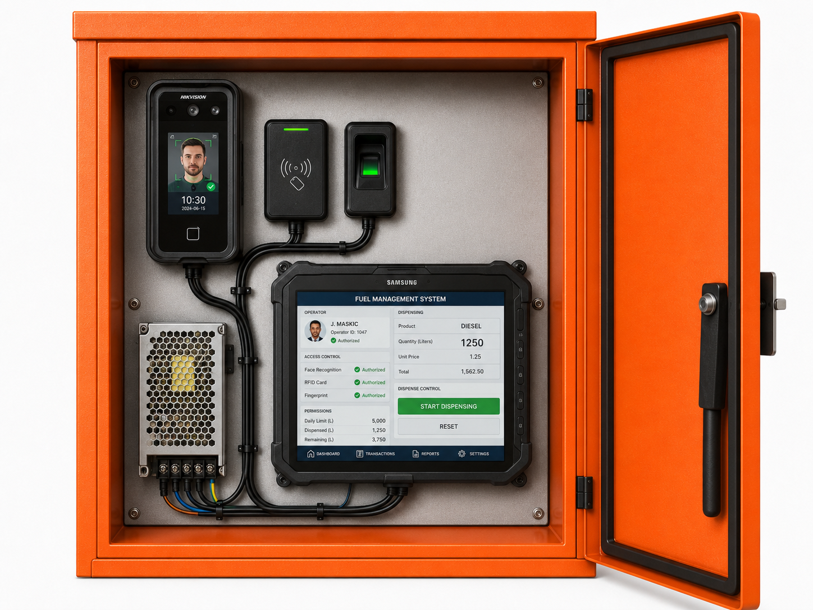
HARDWARE · DIESEL STORAGE TANK
Metering and access control at the diesel storage tank.
TANK
PUMP
IDENTIFICATION & AUTHORISATION
80 GHz radar level
High-accuracy flow meter
Biometrics · RFID · tablet
Accurate to 0.5–1 cm level on the 1,000,000 L tank · Modbus / RS485
Exact volume per dispensing event, with automatic shut-off
Operator by face and fingerprint, locomotive by RFID, on a custom hardened pump tablet; fuel flows only after authorisation

Slide 4
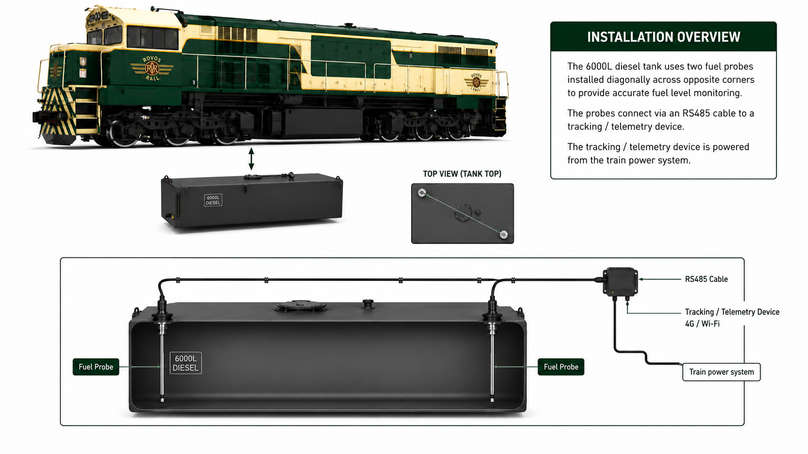
HARDWARE · LOCOMOTIVE
On the locomotive: twin probes in the 6,000 L tank.
6,000 L diesel tank
Diagonally opposed probes — correct for tilt & movement
RS485 → telemetry, 4G / Wi-Fi
Powered from the train system

Slide 5
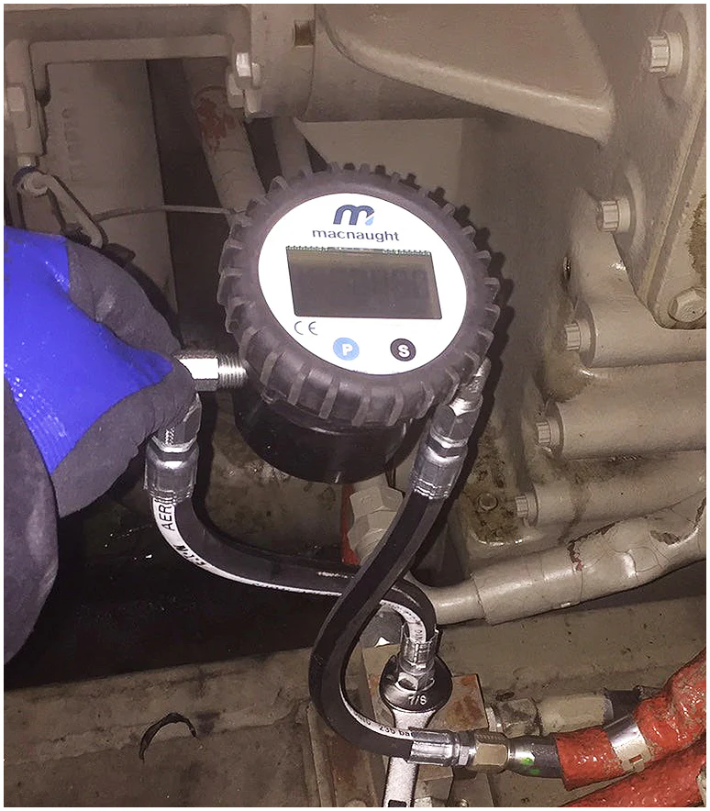
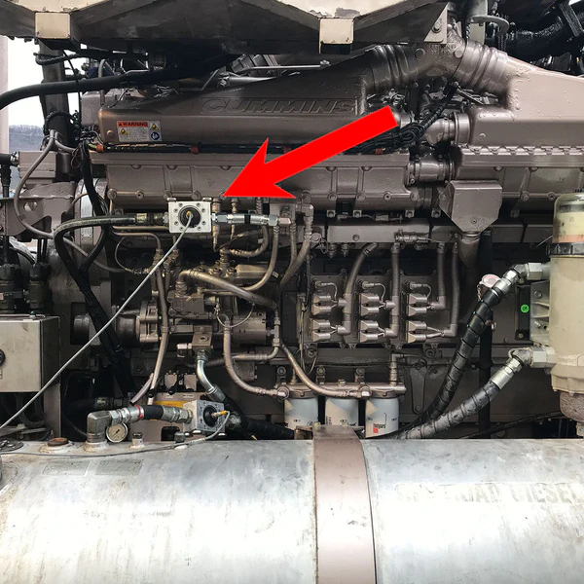
HARDWARE · FIELD INSTALLATIONS
Field-proven equipment, already in service.
High-accuracy Macnaught flow meter, installed inline on an engine fuel line.
In-service installation on a Cummins diesel engine, connected to the telemetry unit — the same approach applies to generator (genset) engines.
Photographs of actual GotYou Telematics field installations.

Slide 6
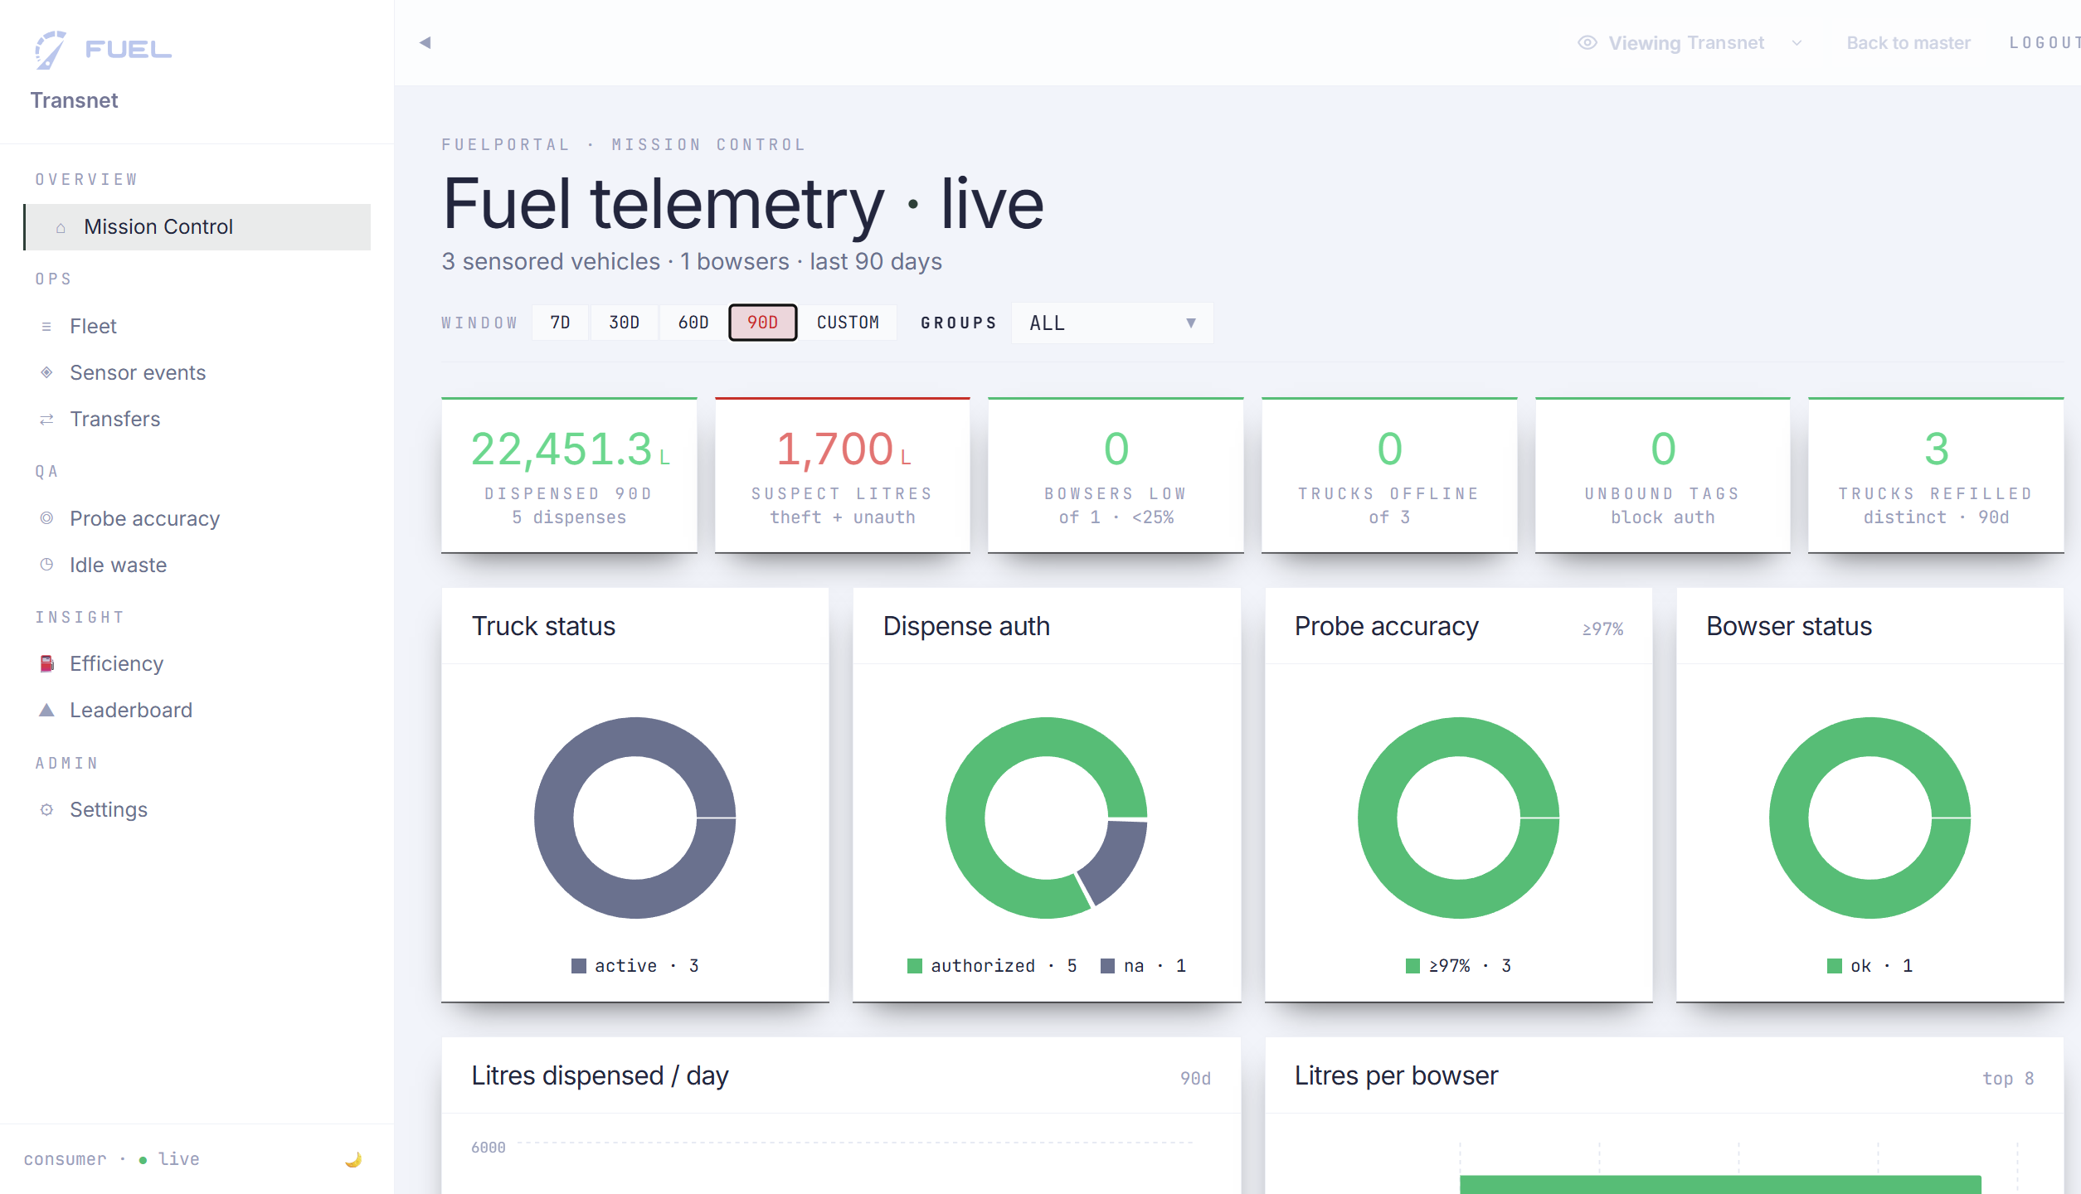
SOFTWARE · MOCK-UP, FULLY CONFIGURABLE
All assets on one view, updated in real time.
Mission Control — fuel telemetry across every storage tank and locomotive, live.
Mock-up populated with sample data — not actual Transnet figures. Every screen and rule is configured to Transnet's operation.

Slide 7
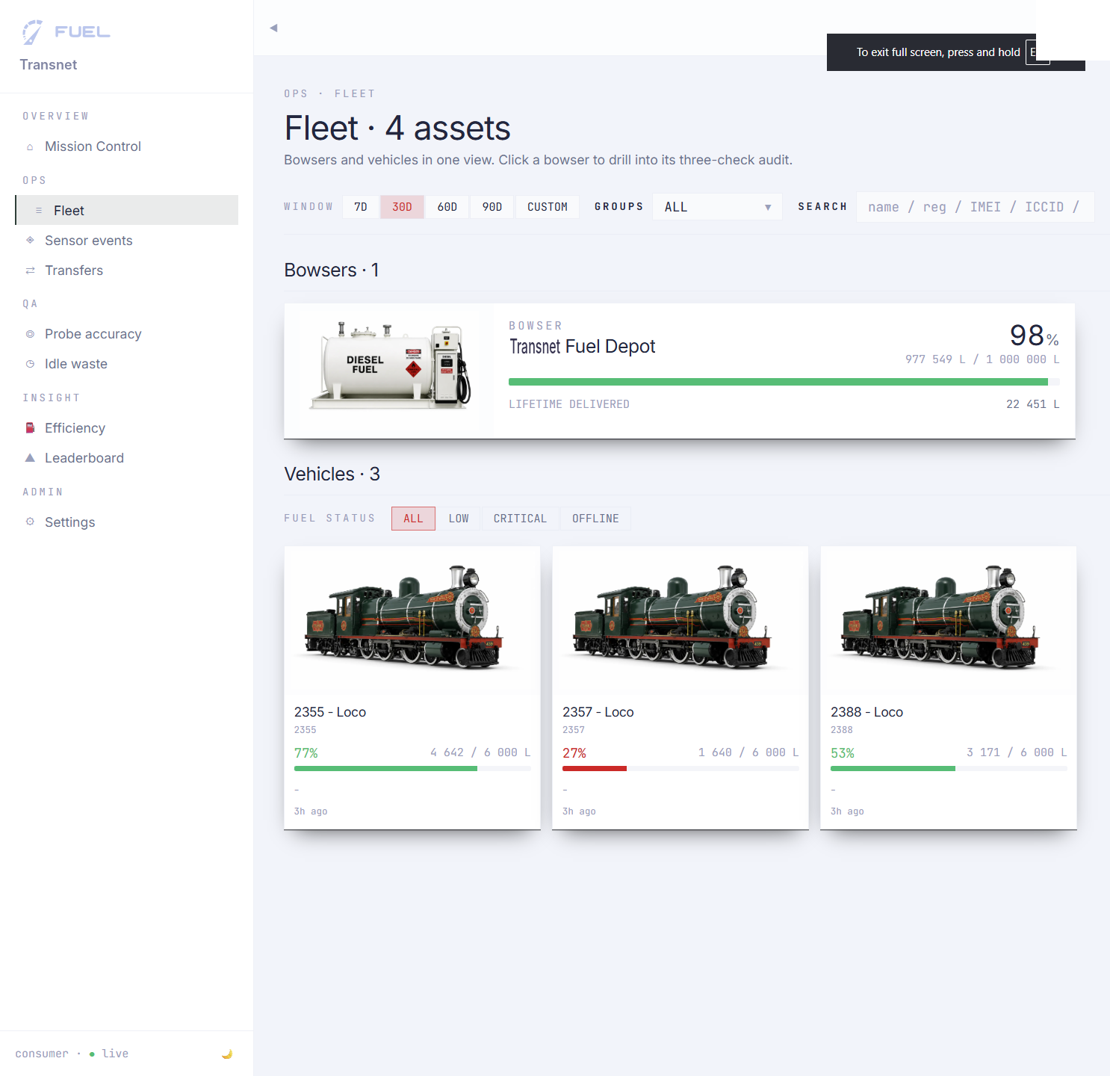
MANAGEMENT DATA · REAL-TIME LEVELS
Fleet view — every tank and locomotive, live.
Storage-tank stock and each locomotive's tank level on one screen, at a glance.
Demonstration / seeded data — not actual Transnet figures.

Slide 8
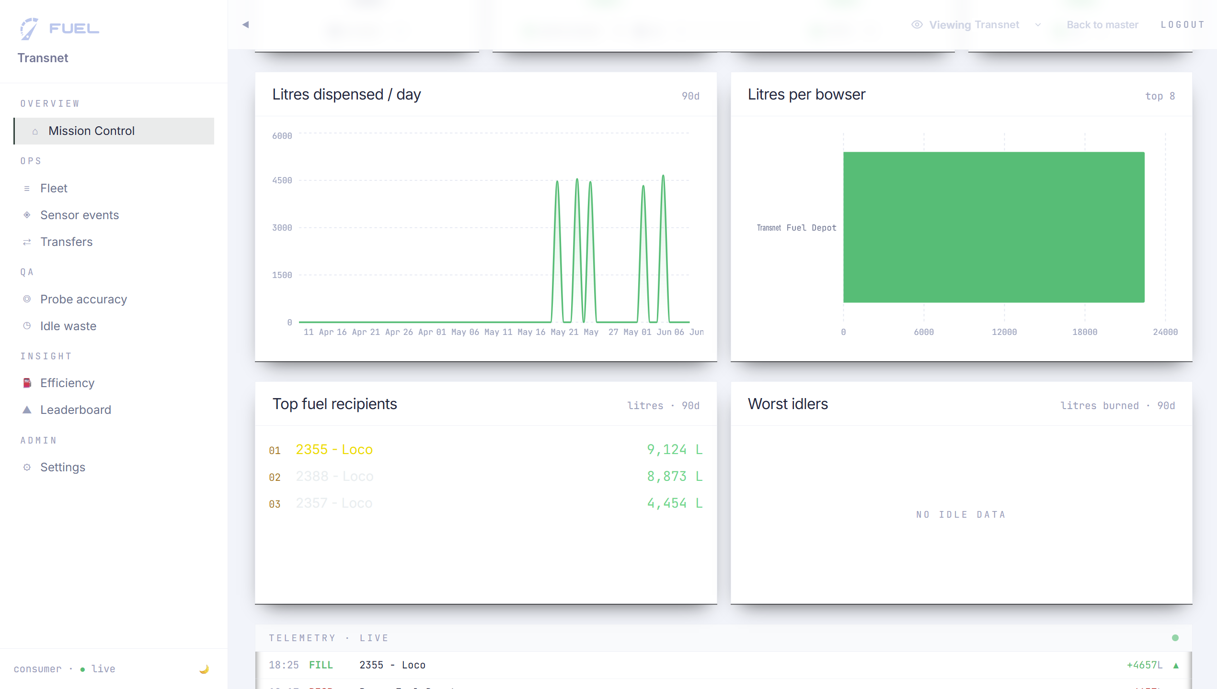
MANAGEMENT DATA · CONSUMPTION
Consumption — by locomotive and by route.
Litres dispensed over time, volume per storage tank, and the highest consumers ranked.
Demonstration / seeded data — not actual Transnet figures.

Slide 9
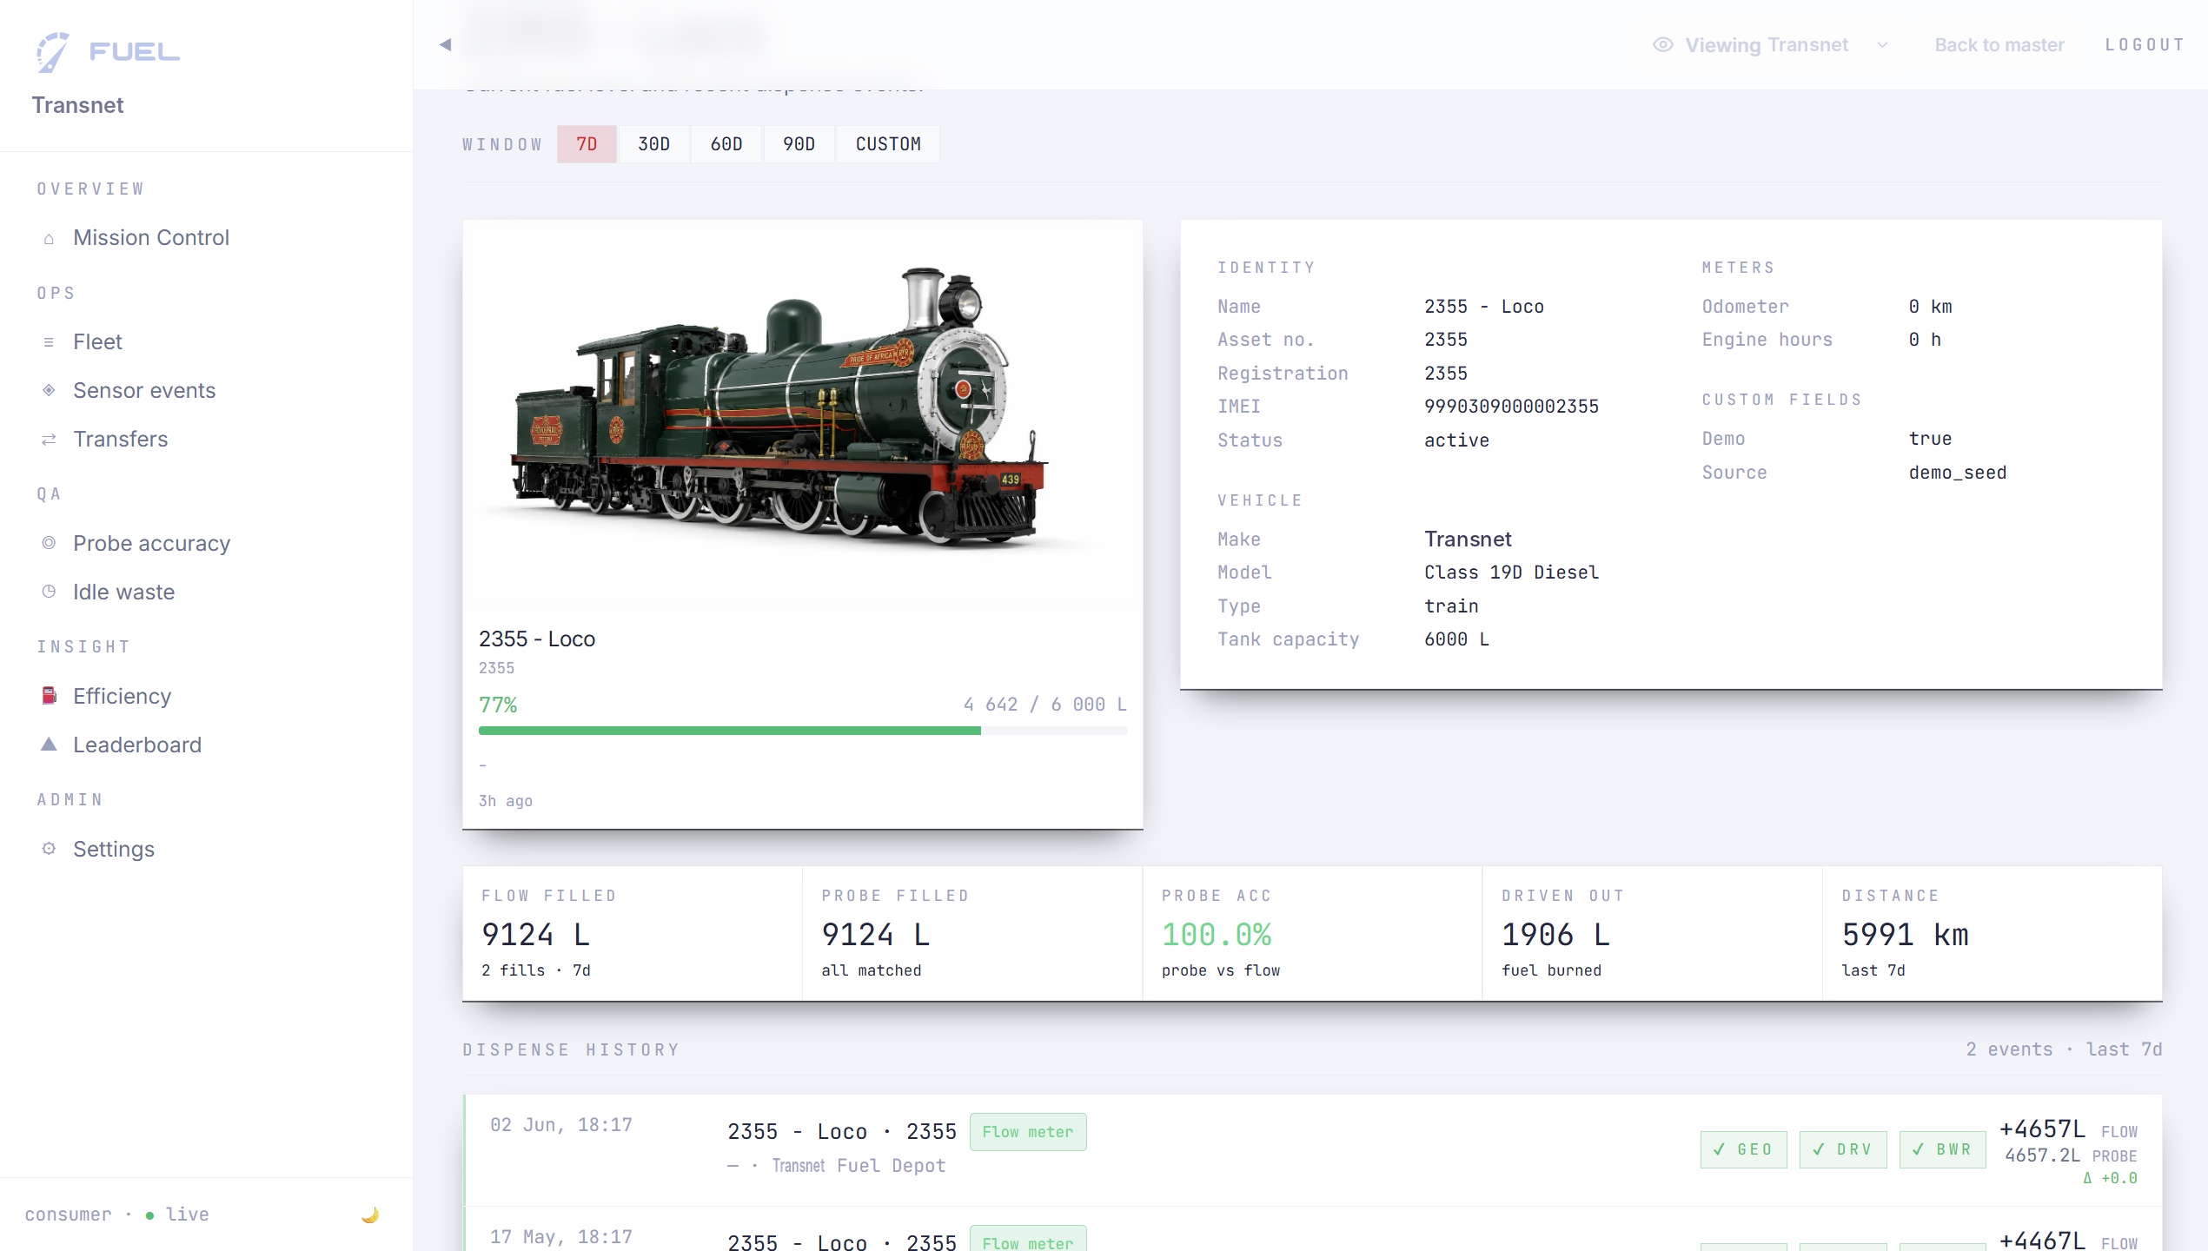
MANAGEMENT DATA · DRILL-DOWN
One locomotive, in full detail.
Tank capacity, flow-versus-probe accuracy, dispense history, distance and consumption.
Demonstration / seeded data — not actual Transnet figures.

Slide 10
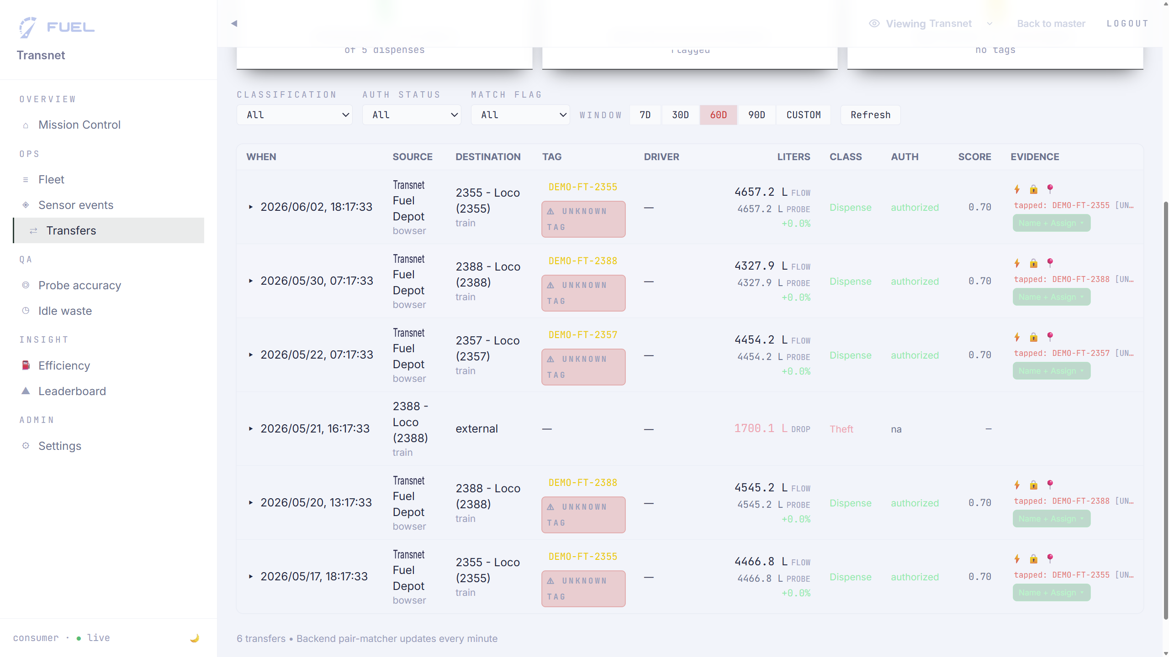
FRAUD & THEFT · AUTHORISATION
Every dispense authorised and evidenced.
Operator, locomotive, authorisation status and classification — dispense versus theft, with evidence.
Demonstration / seeded data — not actual Transnet figures.

Slide 11
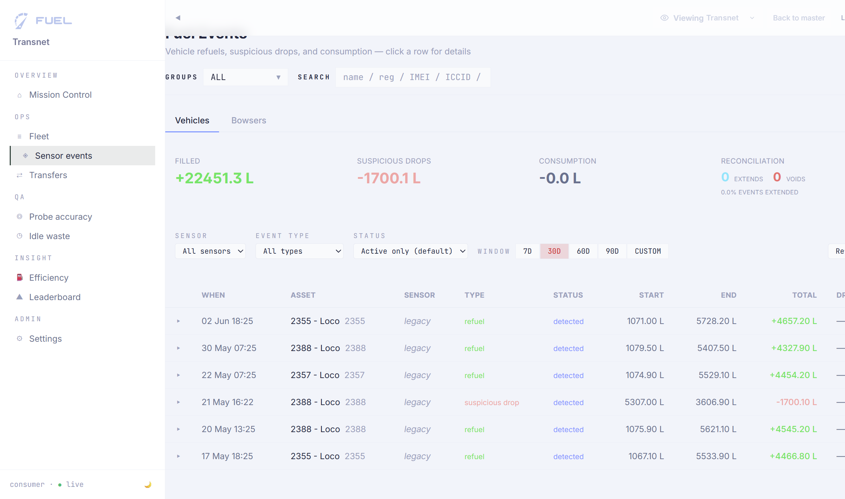
FRAUD & THEFT · SENSOR EVENTS
Sensor events — unexplained drops flagged.
Refuels and suspicious drops, logged per locomotive and per storage tank, with reconciliation status.
Demonstration / seeded data — not actual Transnet figures.

Slide 12
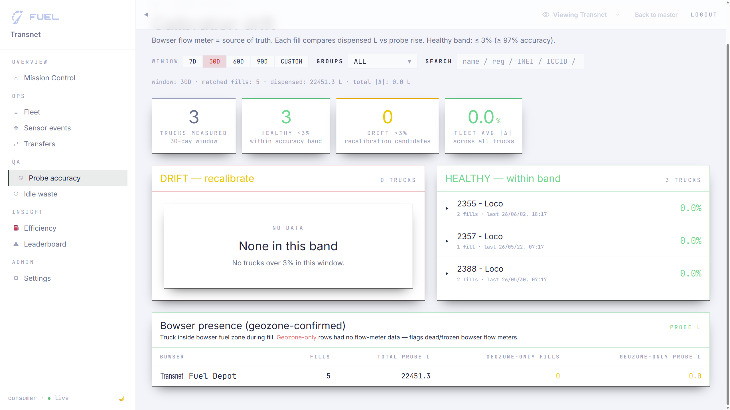
FRAUD & THEFT · RECONCILIATION
Flow versus probe, reconciled within tolerance.
The flow meter is the source of truth; drift beyond the ±3% healthy band is flagged for investigation.
Demonstration / seeded data — not actual Transnet figures.

Slide 13
SUPPLIER · GOTYOU TELEMATICS
Custom software on best-of-breed telemetry hardware.
DISCIPLINE
SOFTWARE
HARDWARE
Telemetry
Built to specification
Proven components
Sensor integration, connectivity and data pipelines.
Application configured to Transnet's assets, workflows and reports.
Radar level sensors, flow meters, RS485 telemetry units.

Slide 14
PROPOSED NEXT STEP · A CONCEPT FOR DISCUSSION
Proof of Concept: one instrumented locomotive.
Scope:
What it demonstrates:
One locomotive — twin tank probes and telemetry
Live access to the GotYou Fuel platform
Real-time tank level on the locomotive
Measured consumption for that locomotive
Unexplained level-drop events flagged
All data live on the GotYou Fuel platform
A minimal, low-risk pilot to validate accuracy and data before any wider rollout.
GotYou supplies the hardware and provides installation support and consulting services; fitment on the locomotive is carried out by Transnet engineers.
A concept for discussion · no pricing implied · scope to be agreed with Transnet.

